Slide 1

Increased Cyber Attacks In Post Pandemic Era-Analysis And Effective Solutions
1
SUBMITTED BY,
SUBIN SABU
(SJC20MCA-2051)
Guided by,
DR.RAHUL SHAJAN
(Assistant professor)
Master Of Computer Applications
Department of Computer Applications
St. Joseph’s College of Engineering and Technology, Palai, Kottayam-686575

Slide 2
Contents
Page No
Introduction………………………………………………………………………………………... 3
Hacking and Type of Hackers……………………………………………………………… ..4
Common Cyber Attacks………………………………………………………………………..6
Cyber Threats in Various Industries after Covid-19……………………………...9
Detection……………………………………………………………………………………………….12
Prevention……………………………………………………………………………………………..13
Penetration Testing………………………………………………………………………………..14
Ethical Hacking……………………………………………………………………………………….16
Conclusion………………………………………………………………………………………………19
References…………………………………………………………………………………………....20
Appendix………………………………………………………………………………………………..24

Slide 3
Introduction
The year 2020 has caused major developments in the cyber world. Fast digitalization of various sectors during pandemic has made the society certainly more vulnerable towards the cyber attacks.
Studies reports of exponential spikes in amount of cyber attacks after covid-19.
Health Sector, Banking and Financial Sector, Educational Sector has affected with these attacks the most.
Most of the mainstream companies are hiring ethical hackers to ensure the security of their services.
Penetration Testing could be an effective solution to the problem since they can identify and report the vulnerabilities to the authorities before the hackers.

Slide 4
Hacking and Type of Hackers
Hacking is the act of compromising digital devices and networks through unauthorized access to an account or computer system. Hacking is not always a malicious act, but it is most commonly associated with illegal activity and data theft by cyber criminals.
A hacker is an individual who uses computer, networking or other skills to overcome a technical problem. The term also may refer to anyone who uses their abilities to gain unauthorized access to systems or networks in order to commit crimes.

Slide 5
White Hat Hackers
They are the good guys of hacking and they tries to protect the data from the attempts of the black hats using the same methods used by the hackers but in an authorized manner. They uses their technical skills to break into systems and check the security level to prevent from future attacks.
Black Hat Hackers
They can be called as the bad guys in hacking. They finds out vulnerabilities and exploits them to gain access to the target and uses them for financial gain and malicious purposes, for gaining reputation etc.
Grey Hat Hackers
They sits in between white and black hat hackers. Unlike black hat hackers they doesn’t use their skills to gain money or other personal benefits. They do breaks the rules and violates standard principles but they can be used for good purposes as well.

Slide 6
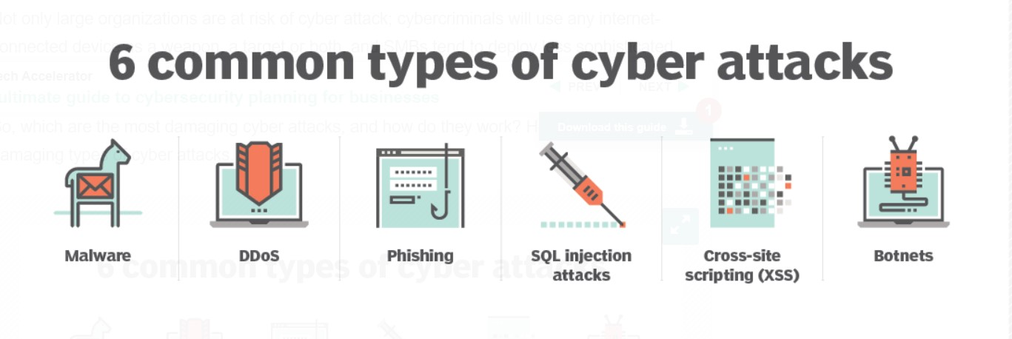
Common Cyber Attacks

Slide 7
Malware
Malware, or malicious software, is an umbrella term used to refer to a hostile or intrusive program or file that is designed to exploit devices at the expense of the user and to the benefit of the attacker.
DDoS
A distributed denial-of-service (DDoS) attack is an attack in which multiple compromised computer systems attack a target, such as a server, website or other network resource, and cause a denial of service for users of the targeted resource.
Phishing
A phishing attack is a form of fraud in which an attacker masquerades as a reputable entity, such as a bank, tax department, or person in email or in other forms of communication, to distribute malicious links or attachments to trick the victim

Slide 8
SQL Injection Attacks
Any website which is supposed to be having a database are vulnerable to this attack. Attackers injects sql queries to the website and extracts the data they wanted.
XSS (Cross Site Scripting)
Cross-site scripting (XSS) attacks can occur when an untrusted source is allowed to inject its own code into a web application and that malicious code is included with dynamic content delivered to a victim's browser.
Botnets
A botnet comprises a collection of internet-connected computers and devices that are infected and controlled remotely by cybercriminals.

Slide 9
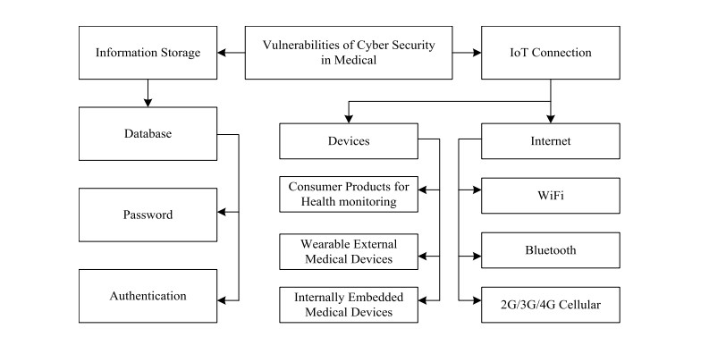
Cyber Threats in Various Industries after Covid-19
Medical Industry
The medical industry is the most affected sector by data breaches after pandemic outbreak. It have resulted in the disruption of operations in domestic health care sector. Underdeveloped technologies are very much vulnerable against cyber threats.

Slide 10
Banking and Financial Industry
Because of the practice of remote working usage of technologies like RDP and VPN has increased by 41% and 33% respectively, in just two months of the Covid-19 outbreak. Outside the health sector, the financial sector has the largest share of cyber events classified as Covid-19-related in recent years.
Reasons
Development and usage of insecure software and platforms for financial needs.
Migration to work from home.
Spam financial campaigns in the name of covid-19.By February 2021, it found that over 6,000 cases of pandemic-related fraud and cybercrime had been reported, with victims having lost £34.5 million.

Slide 11
Educational Industry.
Ransomware attacks became more frequent on educational sector. Times of India says quoting a report that India is the biggest target of cyber threats to educational sectors followed by USA,UK.
58% of the attacks detected in Asia and pacific were targeted on Indian or India based educational institutions and online platforms during the pandemic period.
Many educational institutions are still unaware if their database is under any kind of cyber threat or not.
Low budget for the educational institution is a reason.

Slide 12
Detection
On the assumption that every system is vulnerable or will be in future, it is the detection phase which is responsible for the identification and detection of any possible malware attacks or threats.
Detection techniques used.
Using an Intrusion Detection System (IDS)
Machine Learning (ML)
Other Techniques like Cryptography, Biometrics, Cyber forensics

Slide 13
Prevention
This is the phase of cyber defence which is supposed to be continuously monitoring the system in order to find any existing vulnerabilities or misconfiguration. If any thing is found against the configuration and security policies, necessary actions will be taken to patch the detected vulnerability.
Prevention Techniques
Using of Firewalls.
Using Intrusion Prevention Systems (IPSs)
Configuring Access Control Systems (ACS)

Slide 14
Penetration Testing
This could be the most effective and reliable technique to prevent the cyberattacks. Even though it is not used often pen-testing still remains the best option.
A penetration test, also called a pen test or ethical hacking, is a cybersecurity technique organizations use to identify, test and highlight vulnerabilities in their security posture. These penetration tests are often carried out by ethical hackers.

Slide 15
The most important fact is that Pen Testing can be used for both detection and prevention of cyber attacks.
There is always a possibility that even with the best up to date security measures they might result in vulnerabilities in later future.
This test must be done frequently including the testing of operating system, hardware, networks and even the pen-tester might check the behavior of the employees.

Slide 16
Ethical Hacking
They are the penetration testers whom are widely now being used to secure the data and to prevent from attacks.
To stop a hacker, one needs to think like one and this is the principle that ethical hackers works
They uses the same tools, techniques and highly sophisticated processes that the black hats who are the bad guys or the actual hackers in the cyber world. The difference is that ethical hacking is legal by all means.

Slide 17
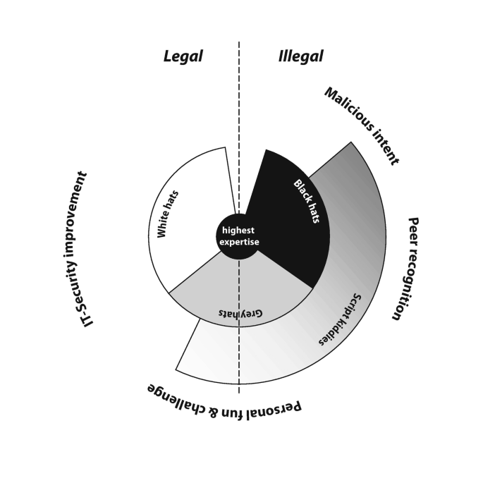
Ethical VS Unethical Hackers
Mainstream companies such as Tesla, IBM, Lenovo, Google etc. are now hiring ethical hackers following the tremors that the pandemic has created in the cyber world. Following the footprints several IT companies are also hiring the same.

Slide 18
The data of the educational institutions which is kept under direct risk of the management itself are still vulnerable. These institutions have Data Base Managers (DBMs) but very small percentage of institutions are conducting proper penetration testing on a regular basis.
CEH (Certified Ethical Hacker) is a course by EC-Council who are the global leaders of InfoSec and Cyber Security. Other providers are.
The Global Information Assurance Certification (GIAC) program is run by the SANS Institute, one of the oldest organizations that provide cybersecurity education.
PEN-200 and OSCP (Offensive Security Certified Professional) by Offensive Security.

Slide 19
Conclusion
90% of the data breaches happened during the post pandemic and pandemic period was because of Cyberattacks.
Despite the data breach increase, the number of victims (20.7 million) decreased 50% compared to Q1 2021 and dropped 41% compared to Q4 2021.Comparing to 2020. This is definitely because of the preventive measures taken by the victims over the past 2 years.
Certified ethical hackers can be an effective solution on the present scenario against the cyber criminals as well as they are a shield against the cyber threats that could make your data in danger.

Slide 20
References
Williams, C. M., Chaturvedi, R., & Chakravarthy, K. (2020). Cybersecurity risks in a pandemic. Journal of medical Internet research, 22(9), e23692.
What is hacking, Types of hacking and more url: https://www.fortinet.com/resources/cyberglossary/what-is-hacking
TechTarget Definition of Hacker url: https://www.techtarget.com/searchsecurity/definition/hacker
WHO reports fivefold increase in cyber attacks, urges vigilance. World Health Organization. 2020 Apr 23. URL :https://www.who.int/news-room/detail/23-04-2020-who-reports-fivefold-increase-in-cyber-attacks-urges-vigilance
Hurricane Katrina fraud. FBI. URL: https://www.fbi.gov/history/famous-cases/hurricane-katrina-fraud
INTERPOL reports showing alarming rate of increased rate of cyberattacks during COVID-19 2020 Aug 4 URL: https://www.interpol.int/en/News-and-Events/News/2020/INTERPOL-report-shows-alarming-rate-of-cyberattacks-during-COVID-19

Slide 21
Johns, E. (2020). Cyber security breaches survey 2020. London: Department for Digital, Culture, Media & Sport
Kumar, S., & Agarwal, D. (2018). Hacking attacks, methods, techniques and their protection measures. International Journal of Advance Research in Computer Science and Management, 4(4), 2253-2257.
64 % of Americans don’t know what to do after a data breach-Do You? , Rob Sobers,2020 Mar 29 url: https://www.varonis.com/blog/data-breach-literacy-survey
Check Point. (2021). Cyber Security Report: 2021.
Muthuppalaniappan, M., & Stevenson, K. (2021). Healthcare cyber-attacks and the COVID-19 pandemic: an urgent threat to global health. International Journal for Quality in Health Care, 33(1), mzaa117.
Aldasoro, I., Frost, J., Gambacorta, L., & Whyte, D. (2021). Covid-19 and cyber risk in the financial sector (No. 37). Bank for International Settlements.

Slide 22
Indian education sector biggest target of cyber threats, remote learning among key triggers:Report. (2022, May 1). Timesofindia.Com. Retrieved June 15, 2022, from https://timesofindia.indiatimes.com/india/indian-education-sector-biggest-target-of-cyber-threats-remote-learning-among-key-triggers-report/articleshow/91234420.cms?utm_source=contentofinterest&utm_medium=text&utm_campaign=cppst
NATO Cooperative Cyber Defence Centre of Excellence. Cyber Definitions. Accessed: Jun 16, 2022. [Online]. Available: https://ccdcoe.org/
Nespoli, P., Papamartzivanos, D., Mármol, F. G., & Kambourakis, G. (2017). Optimal countermeasures selection against cyber attacks: A comprehensive survey on reaction frameworks. IEEE Communications Surveys & Tutorials, 20(2), 1361-1396
Al-Khater, W. A., Al-Maadeed, S., Ahmed, A. A., Sadiq, A. S., & Khan, M. K. (2020). Comprehensive review of cybercrime detection techniques. IEEE Access, 8, 137293-137311
Preventing Cyber Attacks Using Penetration Testing. (2021, March 17). Softwareone. Retrieved June 16, 2022, from https://www.softwareone.com/en-fi/blog/articles/2021/03/15/how-to-prevent-cyber-attacks-through-penetration-testing

Slide 23
Recent Cyber Attacks. (n.d.). Https://Www.Fortinet.Com/Resources/Cyberglossary/Recent-Cyber-Attacks. Retrieved June 17, 2022, from https://www.fortinet.com/resources/cyberglossary/recent-cyber-attacks
Jaquet-Chiffelle, D. O., & Loi, M. (2020). Ethical and unethical hacking. In The ethics of cybersecurity (pp. 179-204). Springer, Cham.
Ethical hacker Odia boy earns praise from Liberian Government. (2021, August 11). The New Indian-Express. Retrieved June 17, 2022, from https://www.newindianexpress.com/good-news/2021/aug/11/ethical-hacker-odia-boy-earns-praise-from-liberian-government-2343171.html
Razaque, A., Amsaad, F., Khan, M. J., Hariri, S., Chen, S., Siting, C., & Ji, X. (2019). Survey: Cybersecurity vulnerabilities, attacks and solutions in the medical domain. IEEE Access, 7, 168774-168797.

Slide 24
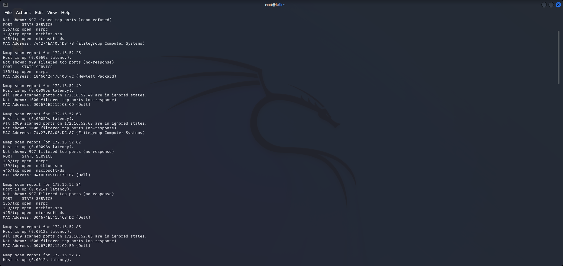
Appendix
The image of an nmap scan performed on our lab network.

Slide 25
THANK YOU

